Slide 1

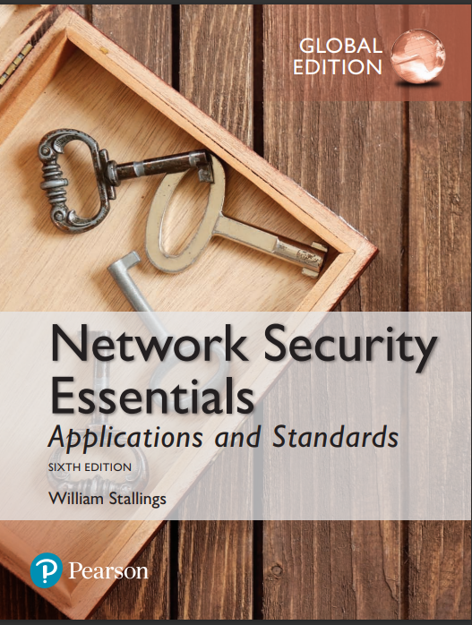
Information Security
By Dr. Taghinezhad
Mail: a0taghinezhad@gmail.com
Notes:
Lecture slides prepared for “Network Security Essentials”, 5/e, by William Stallings, Chapter 1 – “Introduction”.

Slide 2
Chapter 4
Authentication Applications

Slide 3
We cannot enter into alliance with neighboring princes until we are acquainted with their designs. We are not fit to lead an army on the march unless we are familiar with the face of the country--its mountains and forests, its pitfalls and precipices, its marshes and swamps.
—The Art of War, Sun Tzu
是故不知诸侯之谋者，不能预交。不知山林、险阻、沮泽之形者，不能行军。
— 《孙子兵法》九地篇
Notes:
Opening quote.

Slide 4
Outline
Introduction
Kerberos
X.509 Authentication Service
Recommended reading and Web Sites

Slide 5
Authentication Applications
Authentication functions
  developed to support application-level authentication & digital signatures
Kerberos
  a secret-key authentication service
X.509
  a public-key directory authentication service
Notes:
This chapter examines some of the authentication functions that have been developed to support application-level authentication and digital signatures.
Will first look at one of the earliest and most widely used services: Kerberos. Then examine the X.509 directory authentication service.

Slide 6

KERBEROS
In Greek mythology, a many headed dog, the guardian of the entrance of Hades

Slide 7
KERBEROS
Users wish to access services on servers.
Three threats exist:
  User pretend to be another user.
  User alter the network address of a workstation.
  User eavesdrop on exchanges and use a replay attack.

Slide 8
KERBEROS
A centralized authentication server
  From MIT
  To authenticate users to servers and servers to users
  Relies on conventional encryption
    Making no use of public-key encryption
  Allows users to access services distributed in network
    Without needing to trust all workstations
    All trust a central authentication server
Two versions: version 4 and 5
  Version 4 makes use of DES

Slide 9
Kerberos v4 Overview
a basic 3rd-party authentication scheme
have an Authentication Server (AS)
  users initially negotiate with AS to identify self
  AS provides a non-corruptible authentication credential
    ticket granting ticket (TGT)
have a Ticket Granting server (TGS)
  users subsequently request access to other services from TGS based on users’ TGT
Notes:
The core of Kerberos is the Authentication and Ticket Granting Servers – these are trusted by all users and servers and must be securely administered. The protocol includes a sequence of interactions between the client, AS, TGT and desired server.

Slide 10
Kerberos Version 4
Terms:
  C = Client
  AS = authentication server
  V = server
  IDc = identifier of user on C
  IDv = identifier of V
  P_{c} = password of user on C
  ADc = network address of C
  Kv = secret encryption key shared by AS and V
  TS = timestamp
  || = concatenation

Slide 11
A Simple Authentication Dialogue
C  AS: IDc || P_{c} || IDv
AS  C: Ticket
C  V: IDc || Ticket
Ticket = E_{Kv}[IDc || P_{c} || IDv]
Kv shared by AS and Sever (V)
Ticket can be decrypted by Server

Slide 12
Kerberos v4 Dialogue
obtain ticket granting ticket from AS
  once per session
obtain service granting ticket from TGS
  for each distinct service required
client/server exchange to obtain service
  on every service request
Notes:
The full Kerberos v4 authentication dialogue is shown in Stallings Table 14.1, divided into the 3 phases shown above. The justification for each item in the messages is given in Stallings Table 14.2.

Slide 13
Version 4 Authentication Dialogue
Threat
  An opponent will steal the ticket-granting ticket and use it before it expires
Countermeasure
  How to decide the lifetime associated with the ticket-granting ticket?
    If too short  repeatedly asked for password
    If too long  greater opportunity to replay

Slide 14
Version 4 Authentication Dialogue
Authentication Service Exhange: To obtain Ticket-Granting Ticket
C  AS: IDc || IDtgs ||TS1
AS  C: E_{Kc} [K_{c,tgs}|| IDtgs || TS₂ || Lifetime₂ || Tickettgs]
Ticket-Granting Service Exchange: To obtain Service-Granting Ticket
(3) C  TGS: IDv ||Ticket_{tgs} ||Authenticatorc
(4) TGS  C: E_{Kc} [K_{c,v}|| IDv || TS₄ || Ticketv]
Client/Server Authentication Exhange: To Obtain Service
(5) C  V: Ticket_{v} || Authenticatorc
(6) V  C: EKc,v[TS5 +1]

Slide 15
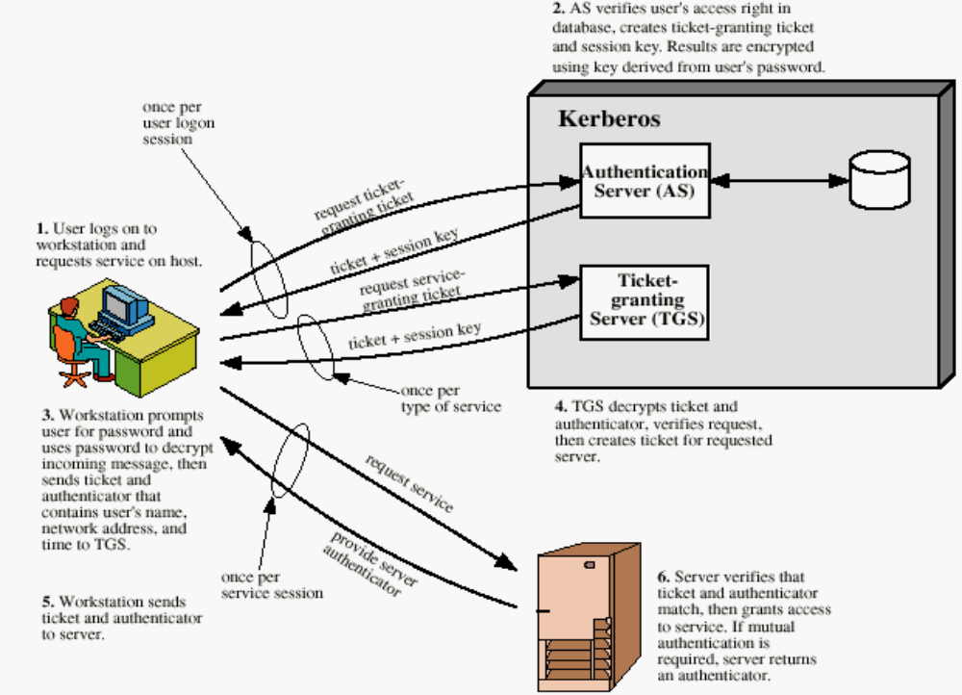
Overview of Kerberos

Slide 16
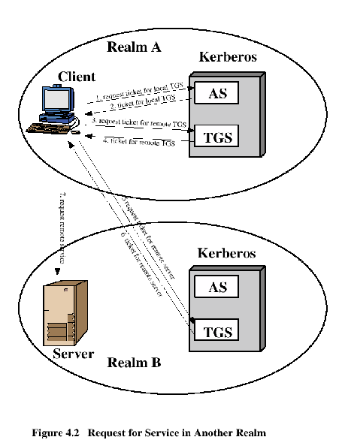
Request for Service in Another Realm

Slide 17
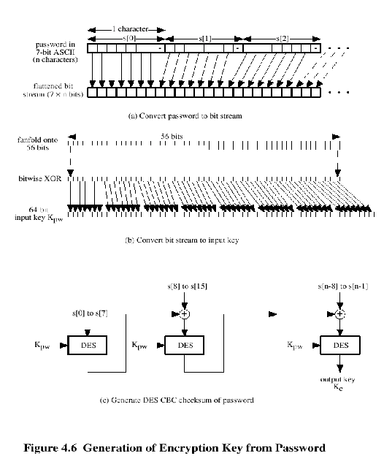
Kerberos Encryption Techniques

Slide 18
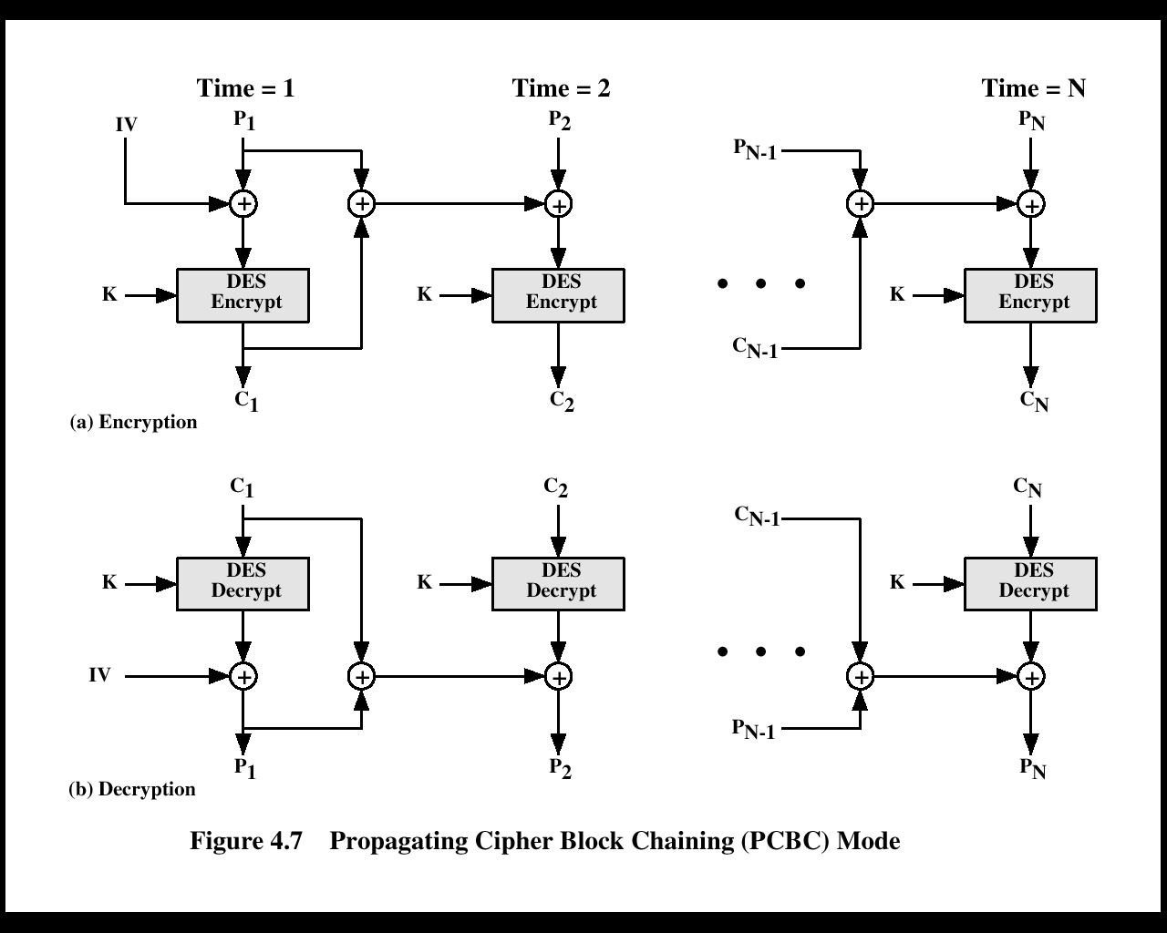
PCBC Mode

Slide 19
Kerberos - in practice
currently have two Kerberos versions:
v4
  restricted to a single realm
v5
  allows inter-realm authentication
  Kerberos v5 is an Internet standard
  specified in RFC1510, and used by many utilities
To use Kerberos:
  need to have a KDC on your network
  need to have Kerberised applications running on all participating systems
major problem - US export restrictions
  Kerberos cannot be directly distributed outside the US in source format (& binary versions must obscure crypto routine entry points and have no encryption)
  else crypto libraries must be reimplemented locally

Slide 20
X.509 Authentication Service
A distributed set of servers that maintain a database about users.
Each certificate contains the public key of a user and is signed with the private key of a CA.
  used in S/MIME, IP Security, SSL/TLS and SET.
  RSA is recommended to use.

Slide 21
X.509 Certificates
issued by a Certification Authority (CA), containing:
  version (1, 2, or 3)
  serial number (unique within CA) identifying certificate
  signature algorithm identifier
  issuer X.500 name (CA)
  period of validity (from - to dates)
  subject X.500 name (name of owner)
  subject public-key info (algorithm, parameters, key)
  issuer unique identifier (v2+)
  subject unique identifier (v2+)
  extension fields (v3)
  signature (of hash of all fields in certificate)
notation CA<<A>>
  denotes certificate for A signed by CA
Notes:
The X.509 certificate is the heart of the standard. There are 3 versions, with successively more info in the certificate - must be v2 if either unique identifier field exists, must be v3 if any extensions are used. These user certificates are assumed to be created by some trusted certification authority (CA) and placed in the directory by the CA or by the user. The directory server itself is not responsible for the creation of public keys or for the certification function; it merely provides an easily accessible location for users to obtain certificates. The certificate includes the elements shown.
The standard uses the notation for a certificate of: CA<<A>> where the CA signs the certificate for user A with its private key.

Slide 22
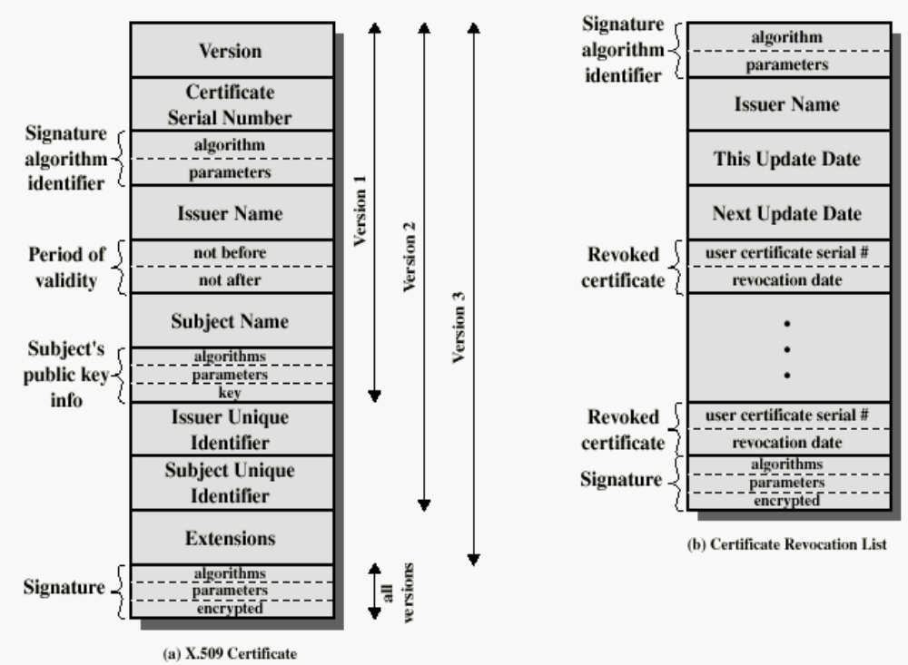
X.509 Formats

Slide 23
Obtaining a User’s Certificate
Characteristics of certificates generated by CA:
  Any user with access to the public key of the CA can recover the user public key that was certified.
  Nobody other than the CA can modify the certificate without this being detected.

Slide 24
CA Hierarchy
X1
X2
both users share a common CA
  they are assumed to know the CA’s public key
    If X<<A>> and X<<B>>, then A has B’s certificate (public key)
  otherwise CA's must form a hierarchy
    A signed by X1, B signed by X2
      If A doesn’t know X2’s public key
        B’s certificate is useless to A
      A can obtain X2’s public key from X1 if X2 is also signed by X1
        X1<<X2>>X2<<B>> -- certification path
use certificates linking members of hierarchy to validate other CA's
  each CA has certificates for clients (forward) and parent (backward)
  each client trusts parents certificates
  enable verification of any certificate from one CA by users of all other CAs in hierarchy
A
B
Notes:
If both parties use the same CA, they know its public key and can verify others certificates. If not, then there has to be some means to form a chain of certifications between the CA's used by the two parties, by the use of client and parent certificates. It is assumed that each client trusts its parents certificates.

Slide 25
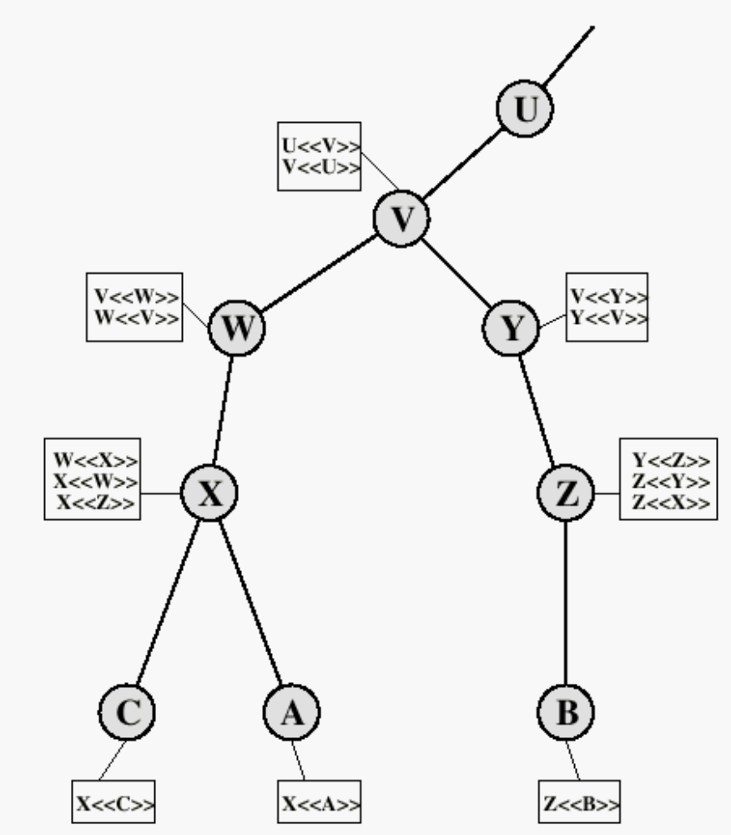
X.509 CA Hierarchy
If X<<A>>, then
(i) A knows X’s public key and
(ii) A can get all the public keys signed by X.
A establishes a certification path to B:
X<<W>>W<<V>>V<<Y>>Y<<Z>>Z<<B>>
B establishes a certification path to A:
Z<<Y>>Y<<V>>V<<W>>W<<X>>X<<A>>

Slide 26
Revocation of Certificates
Reasons for revocation:
  The user’s private key is assumed to be compromised.
  The user is no longer certified by this CA.
  The CA’s certificate is assumed to be compromised.

Slide 27
Authentication Procedures
X.509 includes three alternative authentication procedures:
  One-Way Authentication
  Two-Way Authentication
  Three-Way Authentication
all use public-key signatures
Notes:
X.509 also includes three alternative authentication procedures that are intended for use across a variety of applications, used when obtaining and using certificates. 1-way for unidirectional messages (like email), 2-way for interactive sessions when timestamps are used, 3-way for interactive sessions with no need for timestamps (and hence synchronised clocks). See Stallings Figure 14.6 for details of each of these alternatives.

Slide 28
One-Way Authentication
1 message ( A->B) used to establish
  the identity of A and that message is from A
  message was intended for B
  integrity & originality of message
message must include timestamp, nonce, B's identity and is signed by A
  Timestamp (tA)
    Message generation and expiration time
  Nonce (rA)
    Value must be unique within the expiration time
    Used to detect replay attacks
may include additional info for B
  Eg. session key
Notes:
One way authentication involves a single transfer of information from one user (A) to another (B), and establishes the details shown above. Note that only the identity of the initiating entity is verified in this process, not that of the responding entity. At a minimum, the message includes a timestamp ,a nonce, and the identity of B and is signed with A’s private key. The message may also include information to be conveyed, such as a session key for B.

Slide 29
Two-Way Authentication
2 messages (A->B, B->A) which also establishes:
  the identity of B and that reply is from B
  that reply is intended for A
  integrity & originality of reply
reply includes original nonce from A, also timestamp and nonce from B
may include additional info for A
Notes:
Two-way authentication thus permits both parties in a communication to verify the identity of the other, thus additionally establishing the above details. The reply message includes the nonce from A, to validate the reply. It also includes a timestamp and nonce generated by B, and possible additional information for A.

Slide 30
Three-Way Authentication
3 messages (A->B, B->A, A->B) to enable above authentication without synchronized clocks
has reply from A back to B containing signed copy of nonce from B
  means that timestamps need not be checked or relied upon
Notes:
Three-Way Authentication includes a final message from A to B, which contains a signed copy of the nonce, so that timestamps need not be checked, for use when synchronized clocks are not available.

Slide 31
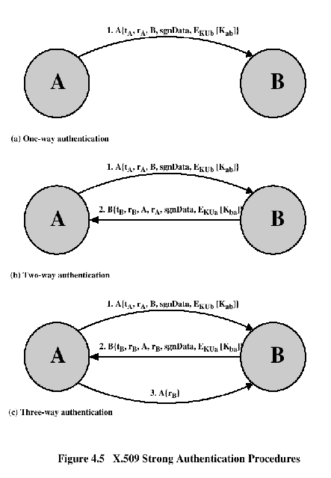
Authentication Procedures

Slide 32
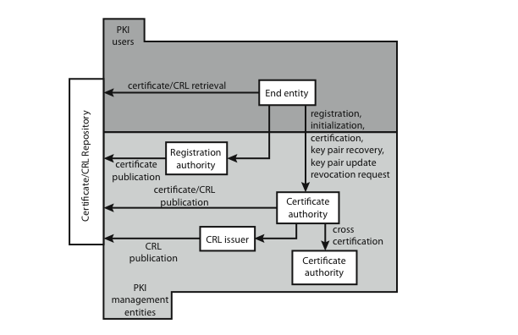
Public Key Infrastructure (PKI)
PKI – the set of hardware, software, people, policies, and procedures needed to create, manage, store, distribute, and revoke digital certificates based on asymmetric cryptography.
  based on X.509
Notes:
RFC 2822 (Internet Security Glossary) defines public-key infrastructure (PKI) as the set of hardware, software, people, policies, and procedures needed to create, manage, store, distribute, and revoke digital certificates based on asymmetric cryptography. The IETF Public Key Infrastructure X.509 (PKIX) working group has setup a formal (and generic) model based on X.509 that is suitable for deploying a certificate-based architecture on the Internet.
Stallings Figure 14.7 shows the interrelationship among the key elements of the PKIX model, and lists the various management functions needed.

Slide 33
Recommended Reading and WEB Sites
www.whatis.com (search for kerberos)
Bryant, W. Designing an Authentication System: A Dialogue in Four Scenes. http://web.mit.edu/kerberos/www/dialogue.html
Kohl, J.; Neuman, B. “The Evolotion of the Kerberos Authentication Service” http://web.mit.edu/kerberos/www/papers.html
http://www.isi.edu/gost/info/kerberos/

